Slide 1
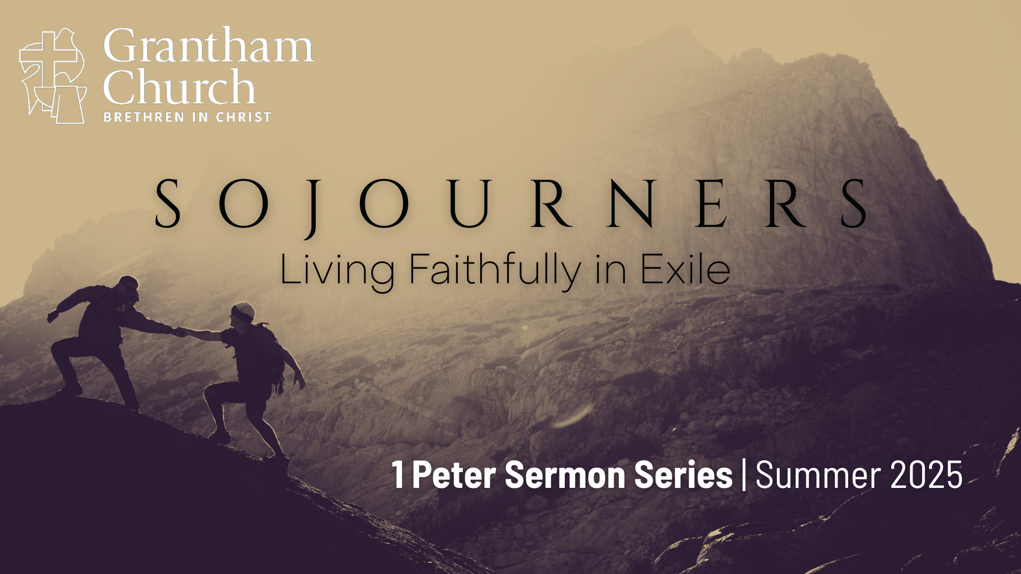
Notes:
Have you ever felt like a stranger in a strange land? [BRIEF COMMENTS]
This morning, we are beginning a new sermon series called, Sojourners: Living Faithfully in Exile, where we will be going verse-by-verse through 1 Peter.
It’s a common refrain in Peter’s first epistle, as well as the rest of the New Testament: we are resident aliens, strangers, foreigners, sojourners, even “exiles” in the present evil age.
Listen to what Peter writes in chapter 2, verses 11-12… [NEXT SLIDE]

Slide 2
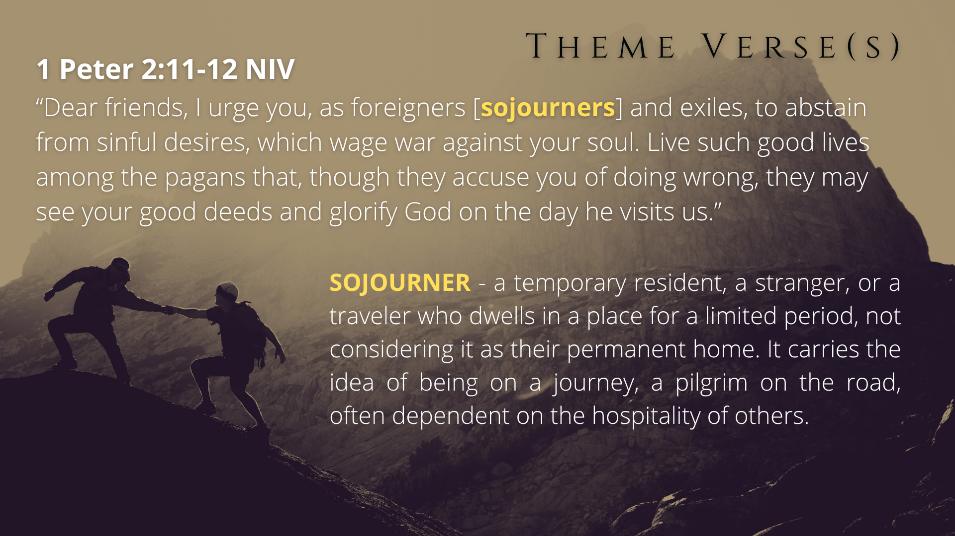
Notes:
“Dear friends, I urge you, as foreigners [“sojourners” – read definition above] and exiles, to abstain from sinful desires, which wage war against your soul. Live such good lives among the pagans [unbelievers] that, though they accuse you of doing wrong, they may see your good deeds and glorify God on the day he visits us.”
These two verses are at the heart and aim of Peter’s letter.
In a world that often feels like it’s not our home, how do we live with courage, integrity, and purpose as disciples of Jesus? The Apostle Peter writes to early Christians as “sojourners and exiles,” offering timeless wisdom for navigating hardship, cultural pressure, and spiritual struggle. And so, in this 9-week series through 1 Peter, we’re going to explore what it means to be God’s chosen people—set apart for his plan and purposes in the world—as we learn how to embrace our identity in Christ, endure suffering with an ever-abiding faith, and live as hopeful witnesses of Jesus in a hostile world.
I’ve entitled this first message… [NEXT SLIDE]

Slide 3
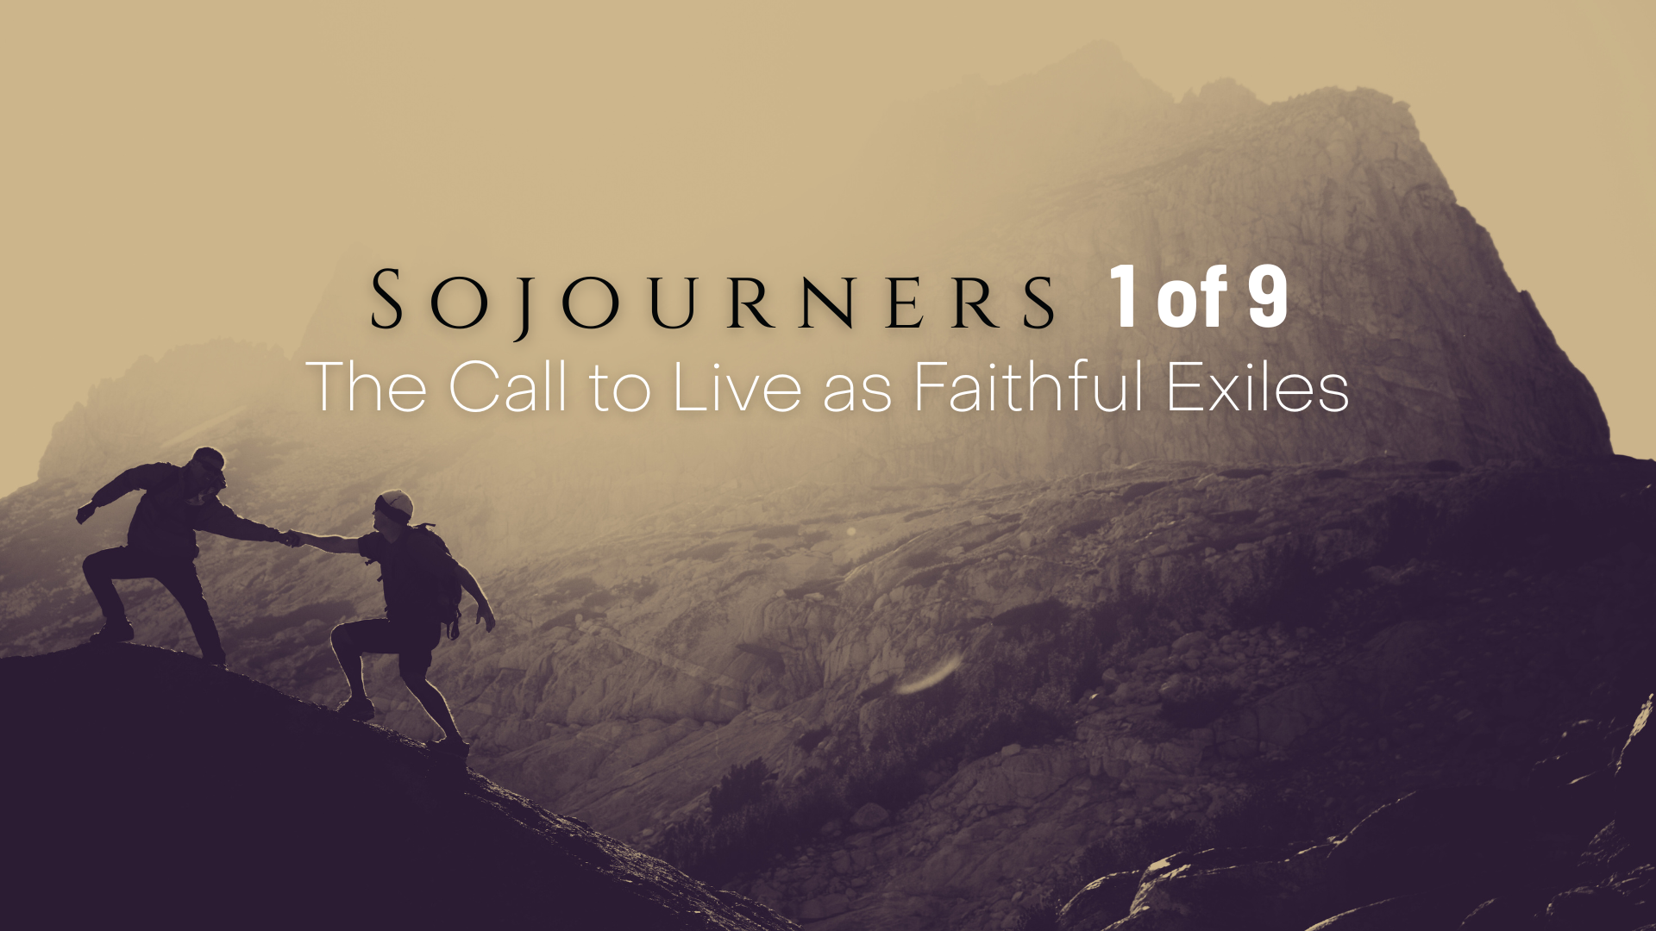
Notes:
The Call to Live as Faithful Exiles, as we’ll be covering the first 12 verses of 1 Peter chapter 1. But before we go any further, let’s pray and prepare our hearts to receive a word from the Lord. Let’s pray… [BRIEF PRAYER]
If you would, go ahead an open the Scriptures to the book of 1 Peter. It’s toward the back of the NT in your Bible…. Hebrews, James, and 1 Peter. And as you’re turning there, listen as I share some basic information on the background and context of this letter… [NEXT SLIDE]

Slide 4
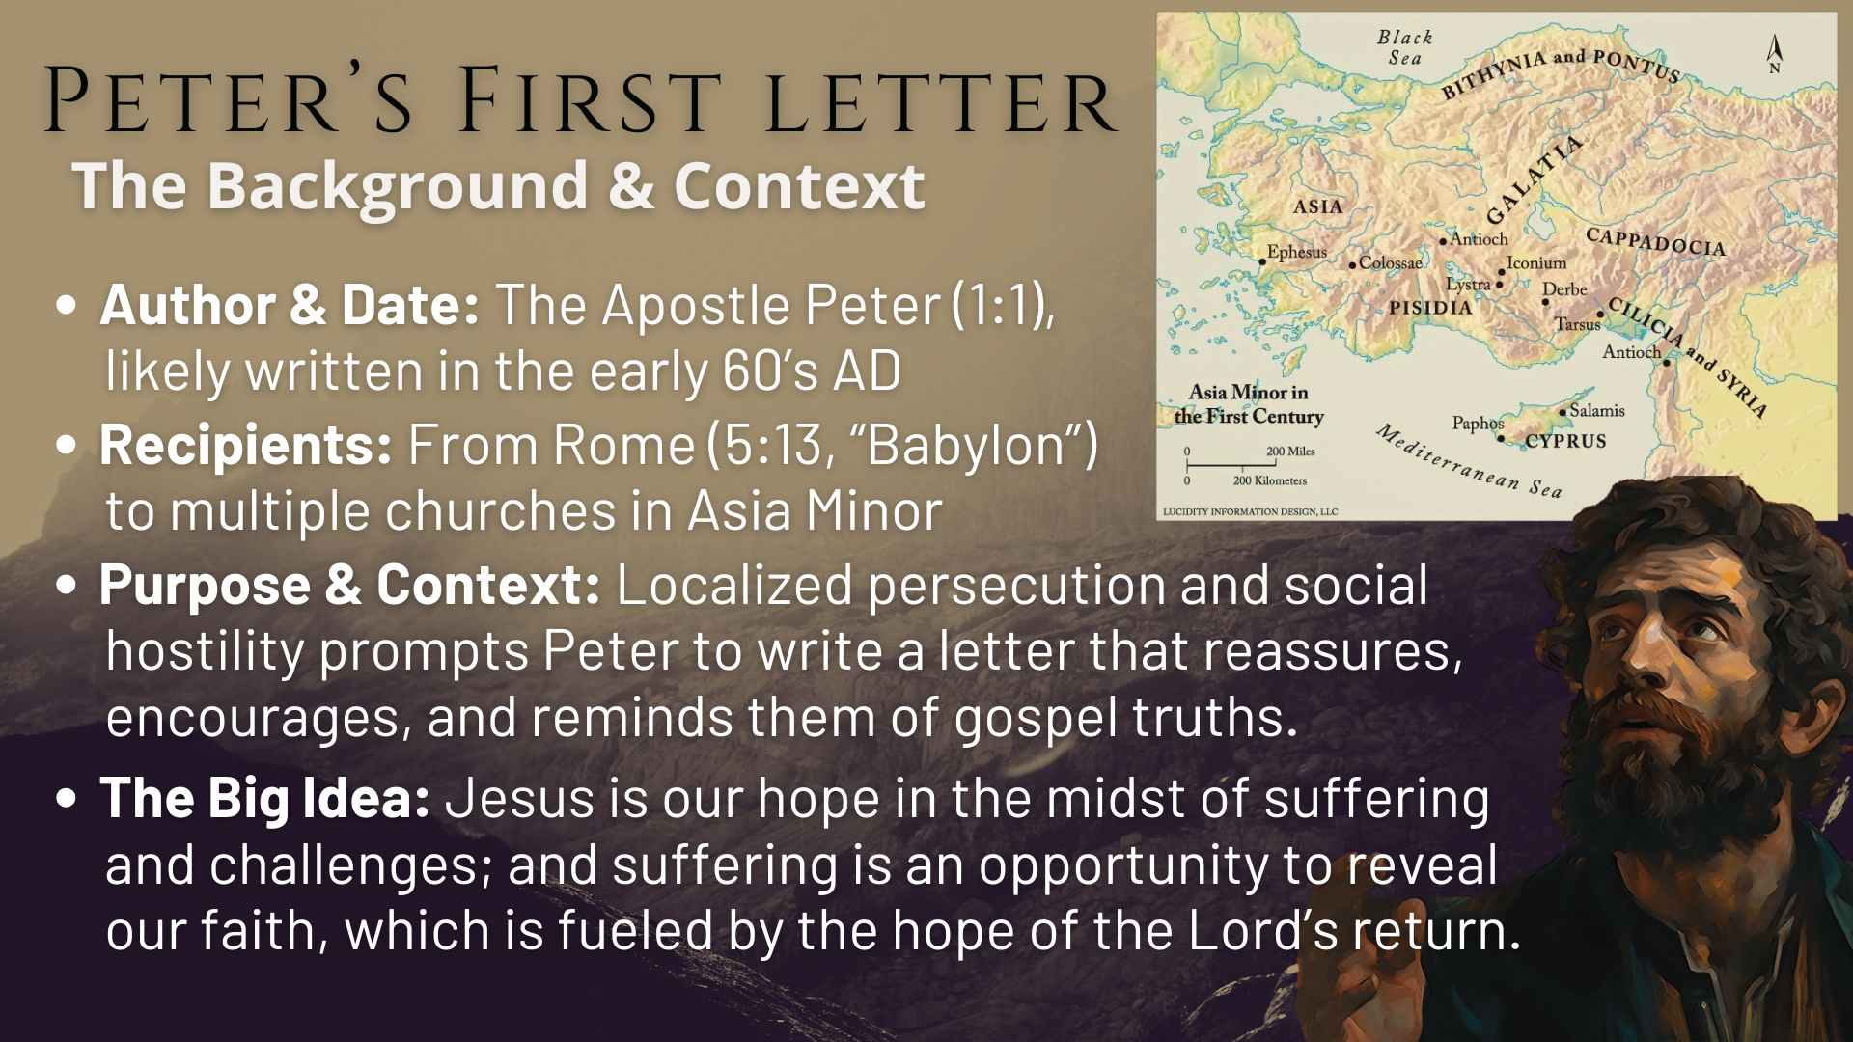
Notes:
[READ & EXPLAIN BACKGROUND & CONTEXT]
Author & Date: The Apostle Peter (1:1), likely written in the early 60’s AD
Recipients: From Rome (5:13, “Babylon”) to multiple churches in Asia Minor
Purpose & Context: Localized persecution and social hostility prompts Peter to write a letter that reassures, encourages, and reminds them of gospel truths.
The Big Idea: Jesus is our hope in the midst of suffering and challenges; and suffering is an opportunity to reveal our faith, which is fueled by the hope of the Lord’s return.
Let’s begin reading now… [NEXT SLIDE]

Slide 5
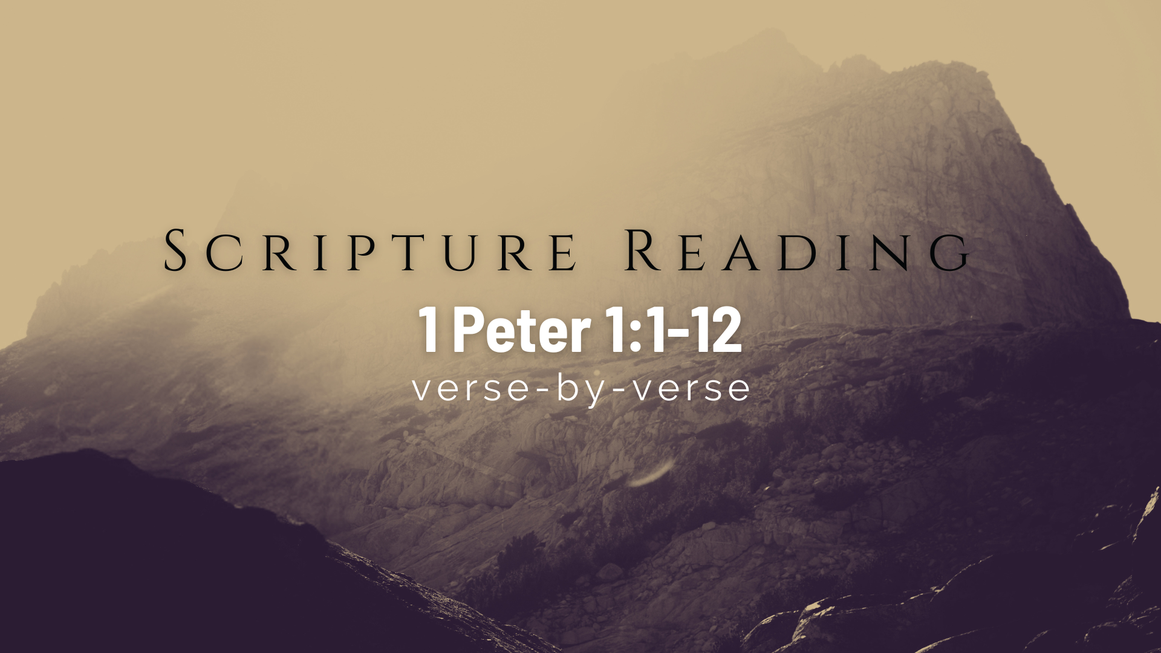
Notes:
with 1 Peter chapter 1, verse 1…
[READ VERSES 1-2]
v. 1 – Peter – “Cephas” in Aramaic; ”Petros” in Greek; meaning “rock” (Matt.16:18)
”elect” – God picked you out like a parents adopts a child
“exiles” – Peter is identifying these Gentile believers with Israel’s story
v. 2 – “chosen according to the foreknowledge of God” – emphasizing God’s desire for them before they ever heard or knew of God; he initiated the inclusion into his family sanctifying work of the Spirit” – for the purposes of being made like God and living like Jesus, “sprinkled with his blood” – in the OT, blood was sprinkled on the people after they accepted the covenant at Mt. Sinai; the blood sealed the covenant.
And so, already in the first two verses, we can hear that we’ve been given a new identity, a new family, a new covenant, that sets us a part in this world as exiles living in a foreign land. That is in keeping with what Jesus prayed about his disciples in John 17… [NEXT SLIDE]

Slide 6
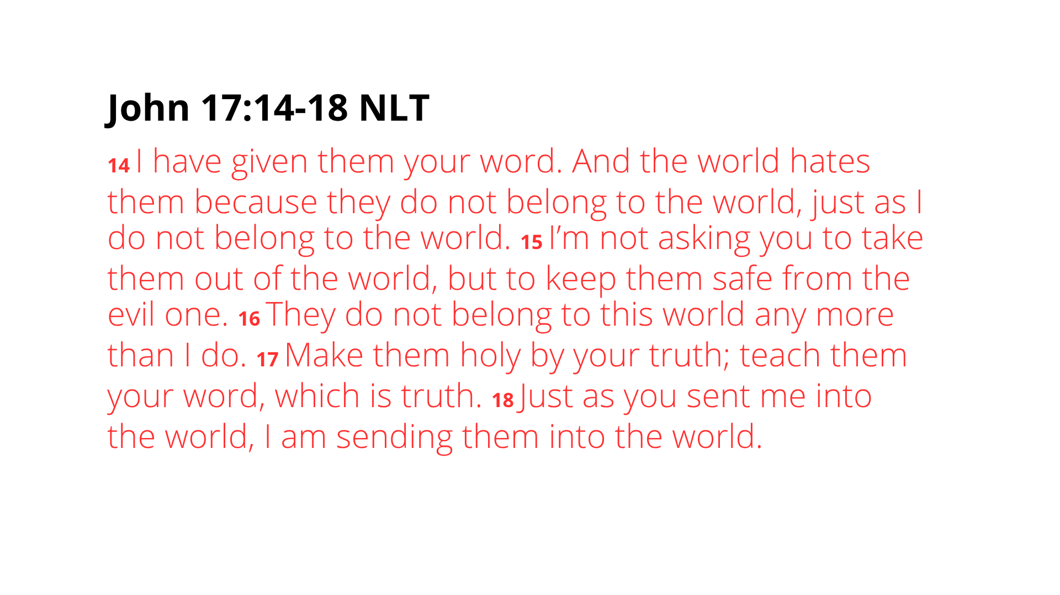
Notes:
[READ PASSAGE & COMMENT]
We should hear Jesus saying very clearly; we belong to him, not this world; we are sojourners, strangers, exiles; we are people (a family, a community) of his word, his truth; and we have a purpose (a mission) to be his hands and feet in this world. As we say often at Grantham, Jesus’ Kingdom is not of this world, but it is for this world. Indeed, we are not of this world, but God has set us a part for this world; the world in which he loves.
Back to Peter chapter one, verse 3… [NEXT SLIDE]

Slide 7
Notes:
[READ VERSES 3-5]
v. 3 – Peter is equating the God of Israel with the God and Father of Jesus!
“new birth” or a “second” birth that is spiritual (of heaven); we are a new creation in Christ, born into a “living hope” (not wishful thinking), because Jesus was raised!
v. 4 – “into an inheritance” and promised reward that is secure and certain to come; it’s safe in heaven and will come from heaven when heaven comes to earth
v. 5 – “through faith are shielded” – Peter uses the military term “guarded” or “protected” by God’s power against anyone or anything that would threaten our identity and the promise and reward of things to come; our faith enables us to experience this until Jesus returns and the Kingdom comes in all its fullness.
Again, don’t miss the contrast between the ways and weapons of this world with the identity and demands of those who claim to follow Christ the King. The Lord’s Kingdom is not of this world, therefore, our citizenship and allegiance is not of this world.
Remember what Paul wrote to the Philippians… [NEXT SLIDE]

Slide 8
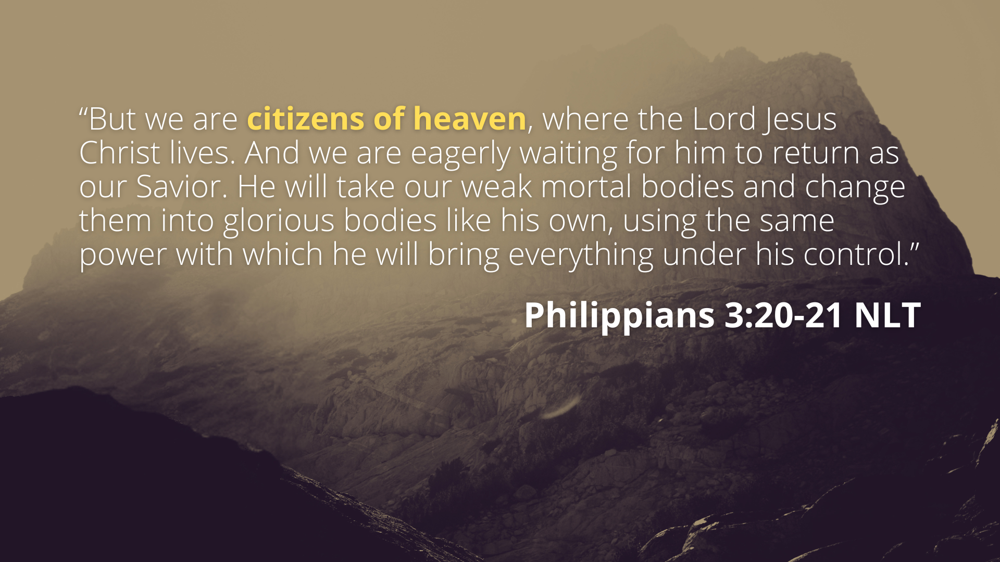
Notes:
[READ PASSAGE & COMMENT]
“Citizens” of heaven – politeuma; our true and ultimate identity is not with the politics or the governments that create borders and draw lines on a map, but with the cosmic Christ and his Kingdom that transcends the toxicity and small-mindedness of nationalism.
You may recall what the author of Hebrews said in chapter 11, where he is describing all of the OT saints whose portraits line the hall of faith, saying… [NEXT SLIDE]

Slide 9
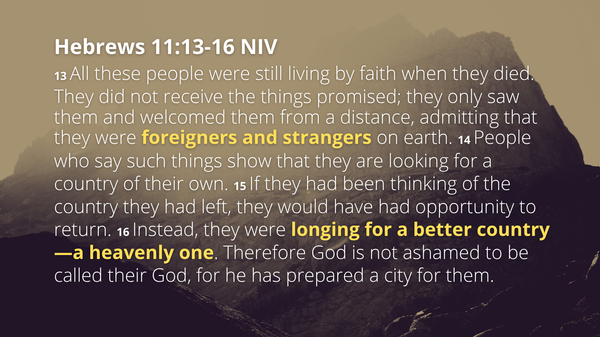
Notes:
[READ PASSAGE & COMMENT]
The things promised: the coming of Messiah, the good news about Christ, new birth into a living hope, the creation of the new Israel—the Church, the Body of Christ.
They also knew they were foreigners, sojourners, and strangers on the earth!
They understood that the tabernacle, the temple, the sacrificial system, the city of Jerusalem, and all the land of Israel were mere shadows of heavenly truths; mere signposts to a greater, higher, divine reality that would someday come with the Messiah
Verse 6… [NEXT SLIDE]

Slide 10
Notes:
[READ VERSES 6-9]
v. 6 – the suffering and trials are temporary, certainly in light of eternity
v. 7 – “genuineness of your faith” – our faith becomes genuine, raw, and pure through hardships; “greater worth than gold” – if gold is purified in intense heat, how much so is it true when it comes to our faith being made pure and real in suffering?
v. 8-9 – Faith without sight is certainly a paradox; but this has been the experience of the vast majority of Christians after Christ ascended to the Father; and yet, we know that our faith and trust in Jesus is real because of the inexpressible joy we have in knowing him and the hope we have in longing for him to return and make all things new.
And so, we must see our suffering as sojourners of Jesus. Because we know where things are going, we can see that God wants to use the heartache, struggle, and the pain of this world to deepen our faith and develop our character. Listen to what Paul wrote… [NEXT SLIDE]

Slide 11
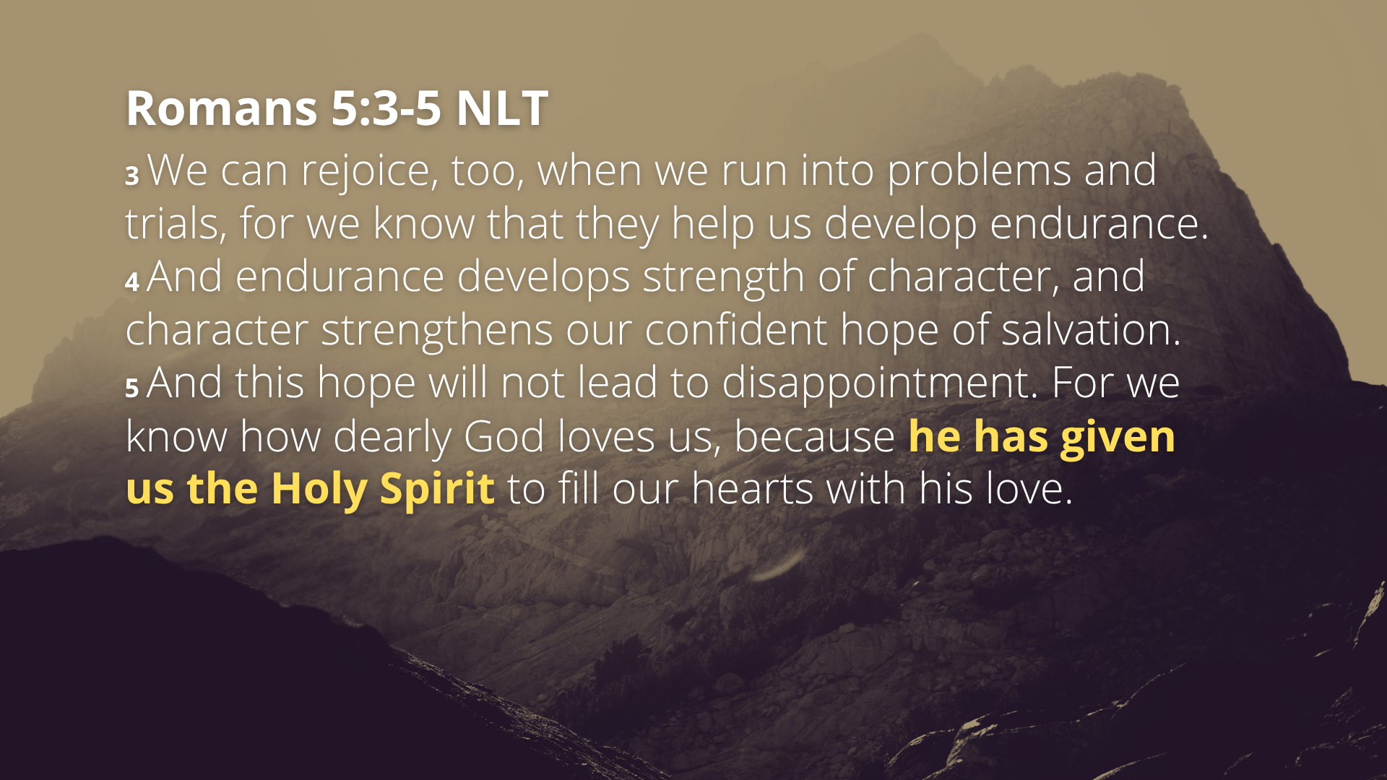
Notes:
[READ & COMMENT]
Just like any kind of exercise or resistance training
The Holy Spirit guides, comforts, and empowers!
There is a dynamic tension here between suffering and the deepening of faith. Consider some of the paradoxes of the Christian faith. Jesus said, “Whoever finds the life will lose it, and whoever loses their life for my sake will find it” (Matt.10:39). Jesus also said, ”Whoever wants to become great among you must be your servant” (Mark 10:43). Also, it can sound strange to our ears when we hear Jesus say, “those who exalt themselves will be humbled, and those who humble themselves will be exalted” (Matt.23:12). Or when James tells us to humble ourselves before the Lord and he will lift us up in due time (Jas. 4:10). It’s paradoxical.
And so it is with what Peter is calling us to do in our suffering. We’re told that even in the midst of our suffering and hardships we can rejoice in the Lord, grow in our faith, be freed from our temptations, hang-ups, and all kinds of carnal bondage… and become more like Christ through it. But too often we resist the work God wants to do through these challenges.
But let’s say we don’t want to resist what God wants to do through our pain and sorrow. Let’s say that we want to allow God to use our suffering to deepen our faith and character; to make us more into what God wants us to be as healthy and whole human being. What are some helpful tools or ways that we can allow God to bring meaning and purpose in the pain? What can we do to encourage and maintain a posture of yieldedness to God in all things?
Let’s consider three primary tools and practices available to us… [NEXT SLIDE]

Slide 12
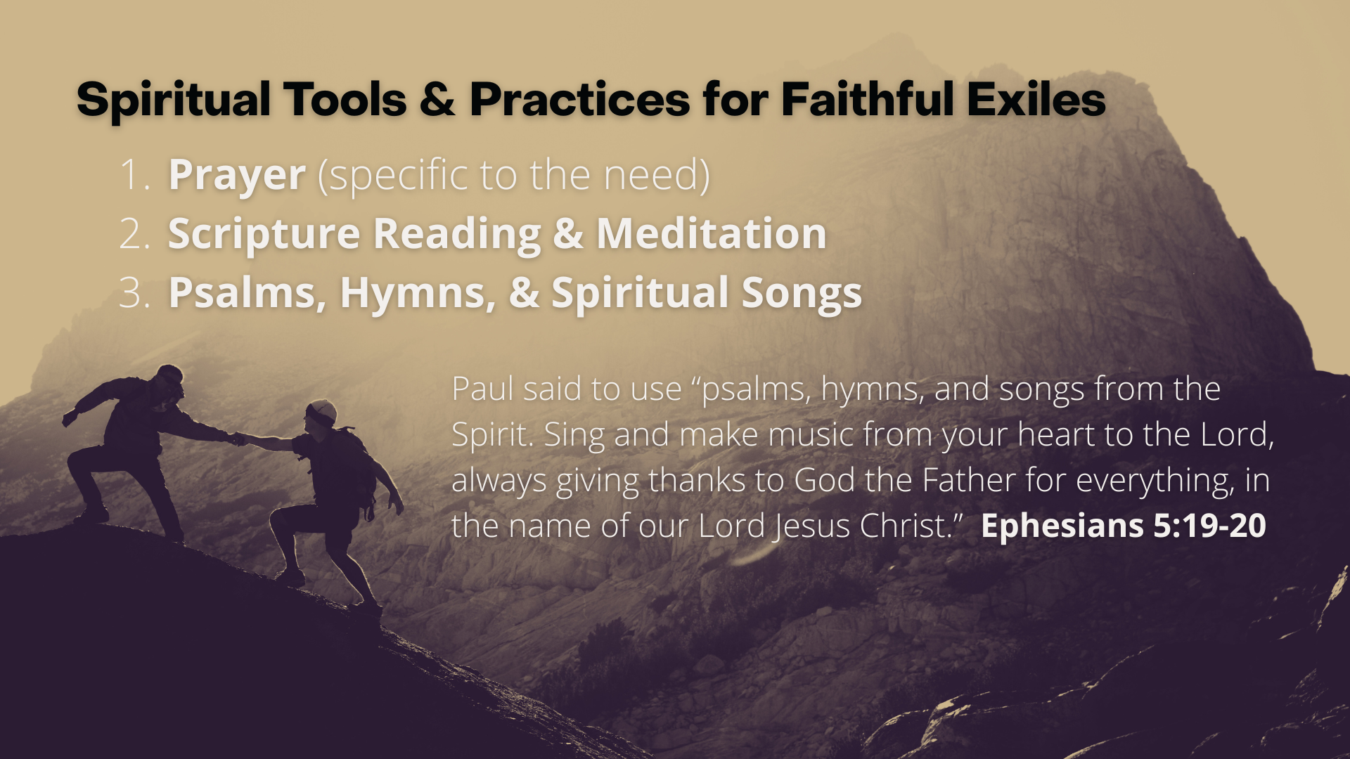
Notes:
[READ & COMMENT]
Prayer (specific to the need)
Scripture Reading & Meditation
Psalms, Hymns, & Spiritual Songs
Psalms – the prayer and songbook of the Bible
In his commentary on 1 Peter, NT scholar Dennis Edwards talks about how Negro Spirituals were and are music of dynamic tension. Dennis wrote that these “Songs gew out of the dynamic tension of living with faith in God who promises deliverance while simultaneously experiencing the slave master’s whip.” He says, “The spirituals helped the slaves affirm that they were not defined by their work; their identity was rooted in a spiritual reality that transcended their circumstances.” Here is an example of a Negro Spiritual that Edwards includes in The Story of God Bible Commentary… [NEXT SLIDE]

Slide 13
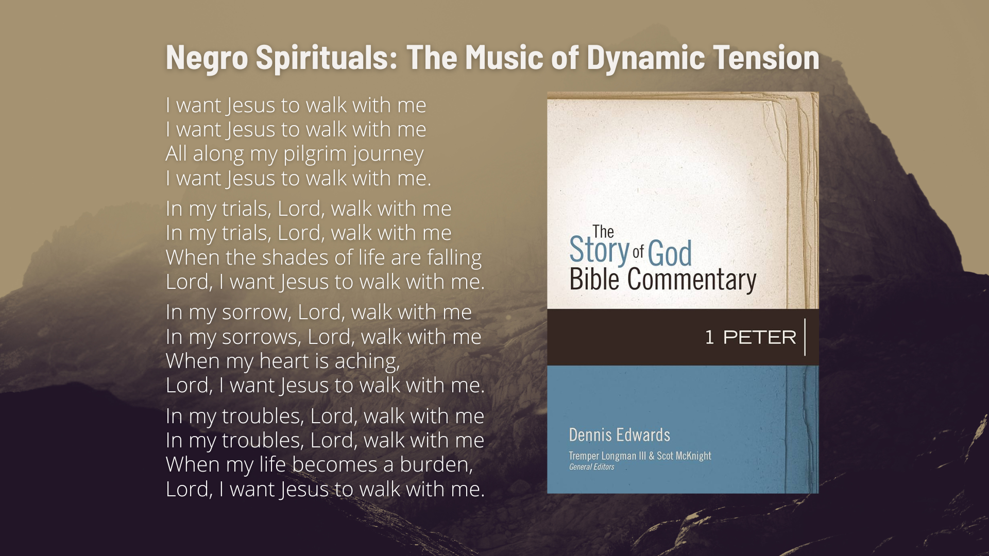
Notes:
[READ & COMMENT]
Let’s listen to this spiritual from Paul Zach’s 2021 album called, Hymns… [NEXT SLIDE]

Slide 14

Notes:
[PLAY VIDEO OF SONG]
[GO TO NEXT SLIDE ONCE VIDEO IS FINISHED]

Slide 15
Notes:
Finally, let’s read through the last few verses for today…
[READ VERSES 10-12 & COMMENT]
To sum up what we’ve heard in this message, and to help us with applying it to our lives, here are some takeaways for us to consider… [NEXT SLIDE]

Slide 16
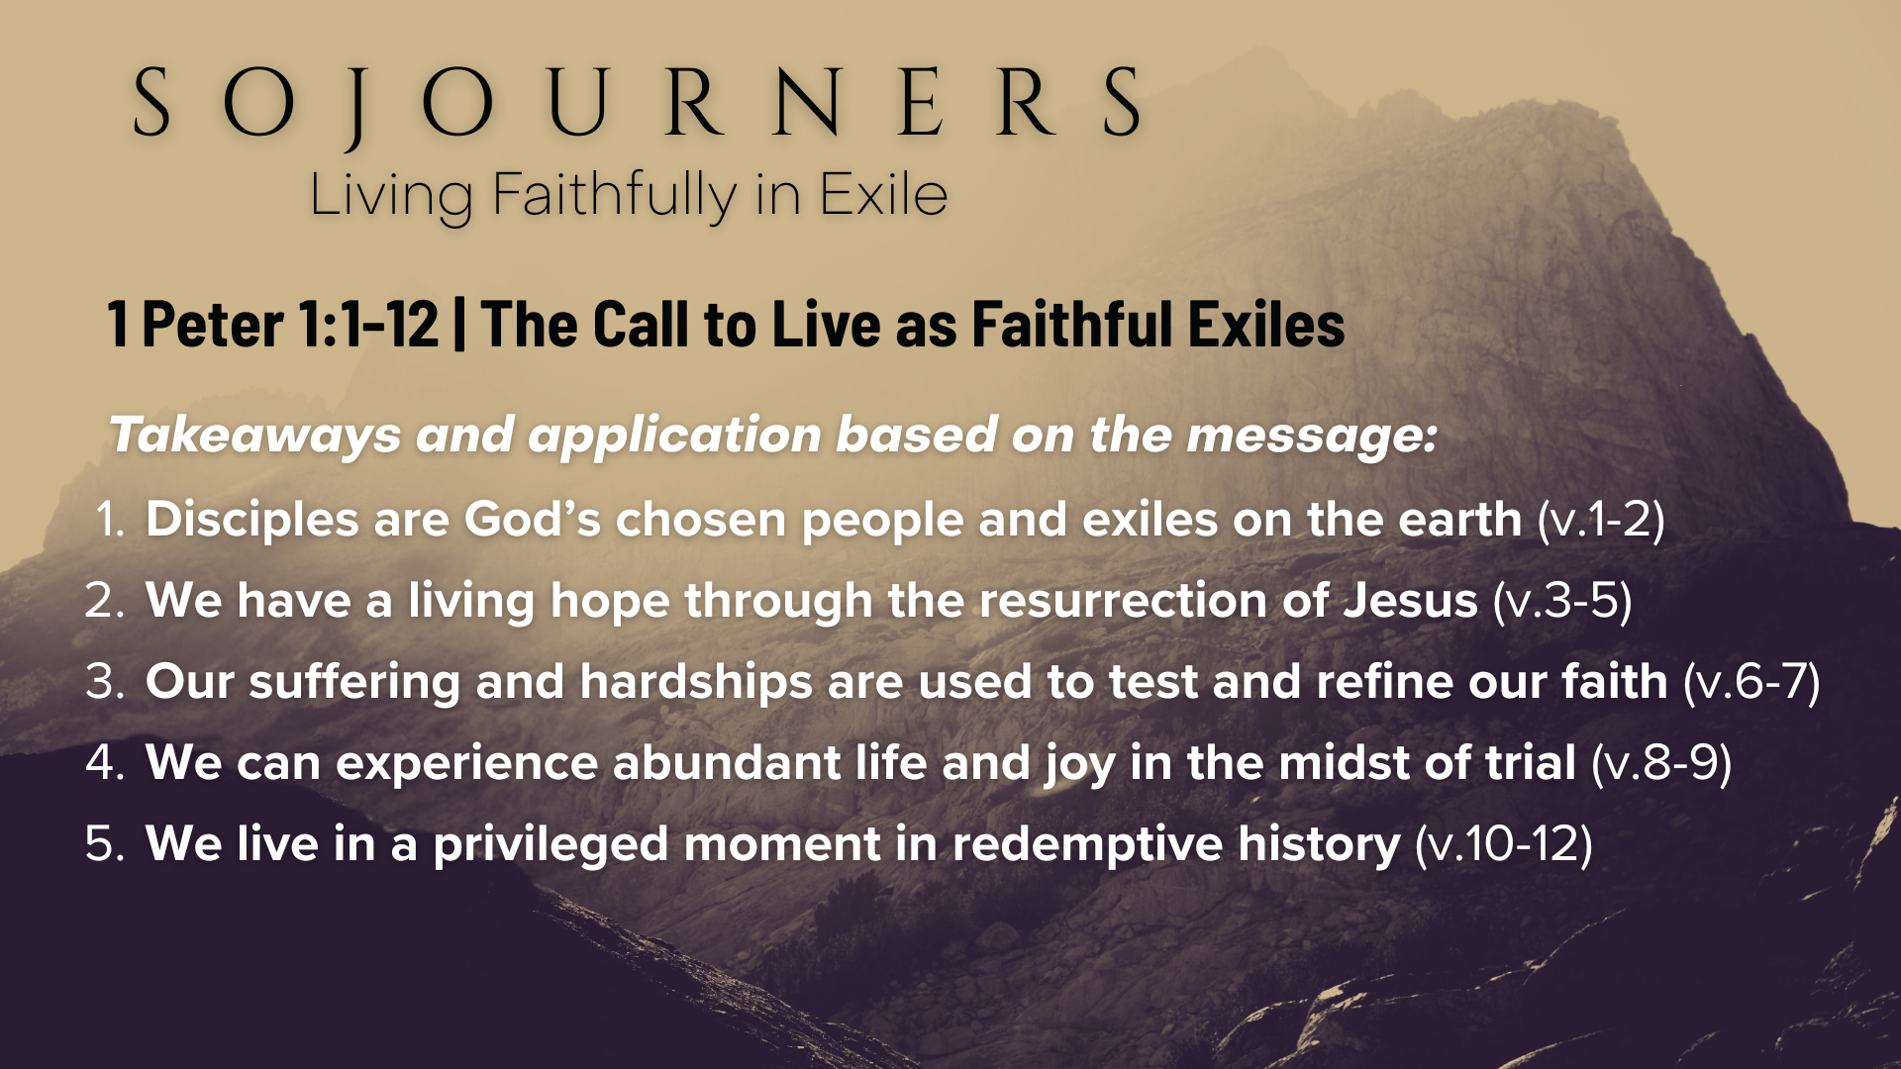
Notes:
[READ EACH MAIN TAKEAWAY ON SLIDE & COMMENT]
We should not expect to be at home in a world that does not share our values. And we should have a real sense of that at times; we’re called to live as faithful exiles.
In times of suffering, disciples can endure because we have a secure future—the resurrection of Jesus tells us where all of God’s people and creation are headed.
As Christians, we should view suffering not as a sign of God’s absence, but as a means of spiritual formation and an opportunity to glorify God and grow through perseverance.
The joy of a disciple is not tied to external ease and comfort but to the ongoing reality of salvation and the assurance we have through our relationship with the risen Christ.
As we saw in our last series, we are in the last days; God has revealed himself in Jesus and so we should respond with a deep abiding trust in the Lord because we’ve been given the gospel of Christ; we are a part of the faithful remnant of God’s people; in the final chapter of God’s story! What a joy. What a privilege. What an opportunity.
Brothers and sisters, Peter has opened his letter with encouragement to scattered “exiles” across Asia Minor, but his words are also for us who are scattered across North America. He begins by reminding us that our identity is in Christ, who has given us new birth into a living hope through the resurrection of Jesus Christ from the dead.
And it’s because of this belief in Christ and God’s good future that we can follow Jesus and live faithfully in exile. Therefore, may we accept the call to be sojourners and to live as faithful exiles until heaven comes to earth. Amen?
Here are some questions for reflection and to help us respond… [NEXT SLIDE]

Slide 17
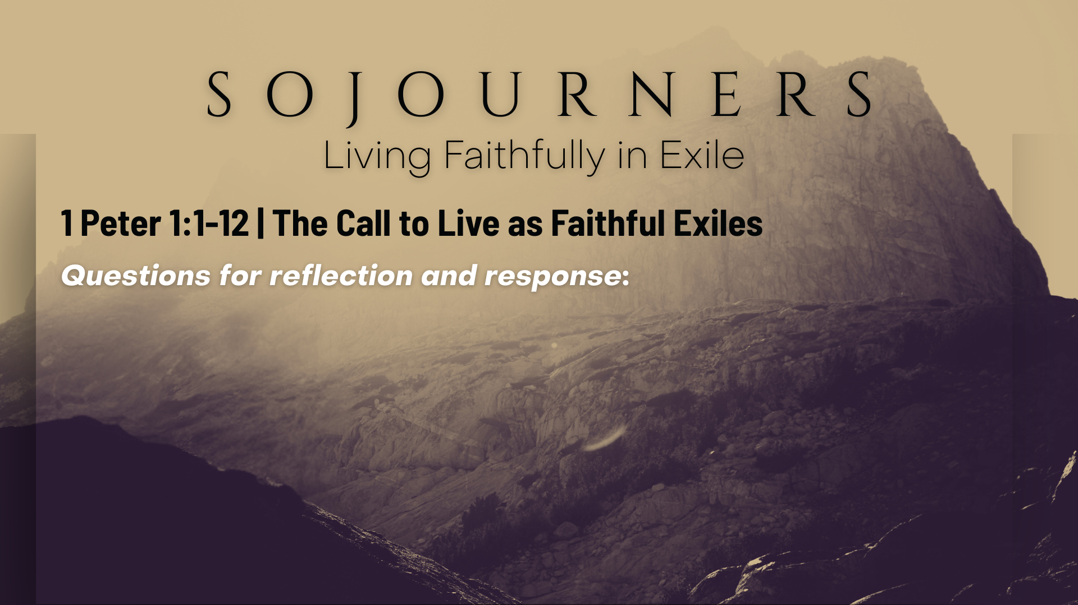

Slide 18
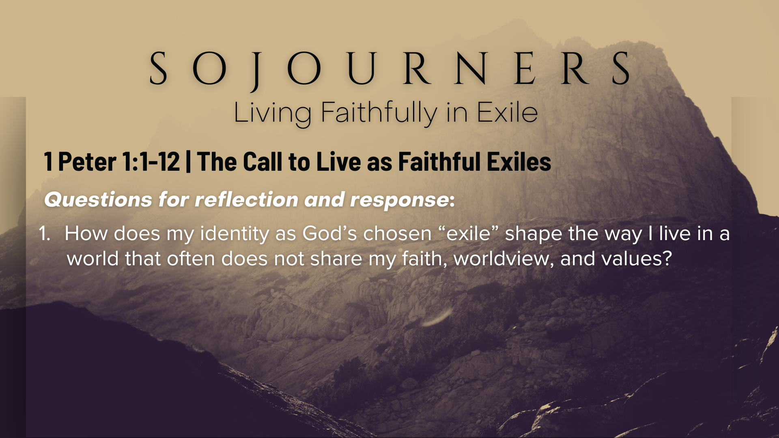

Slide 19
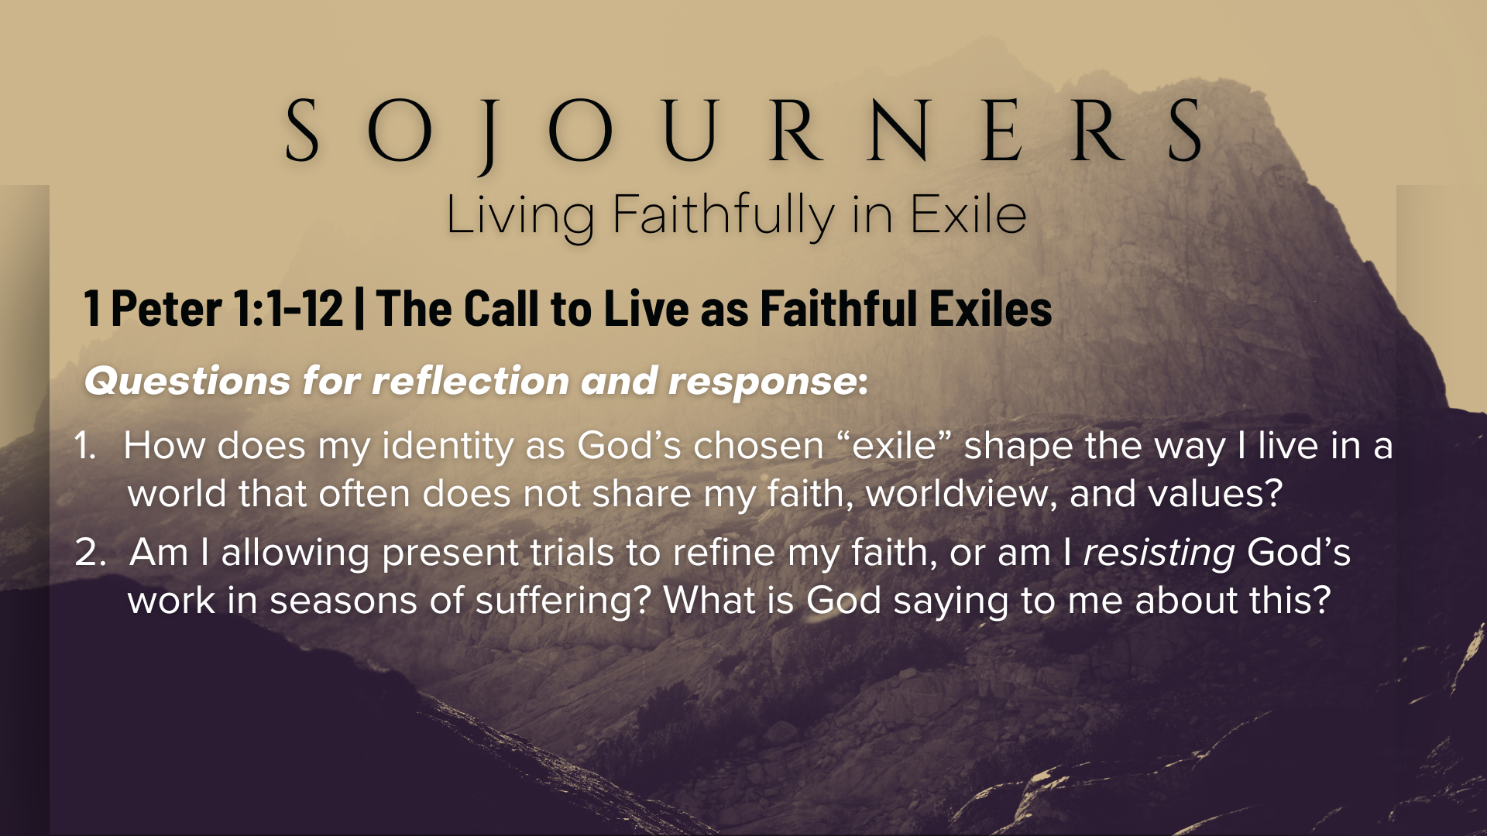

Slide 20
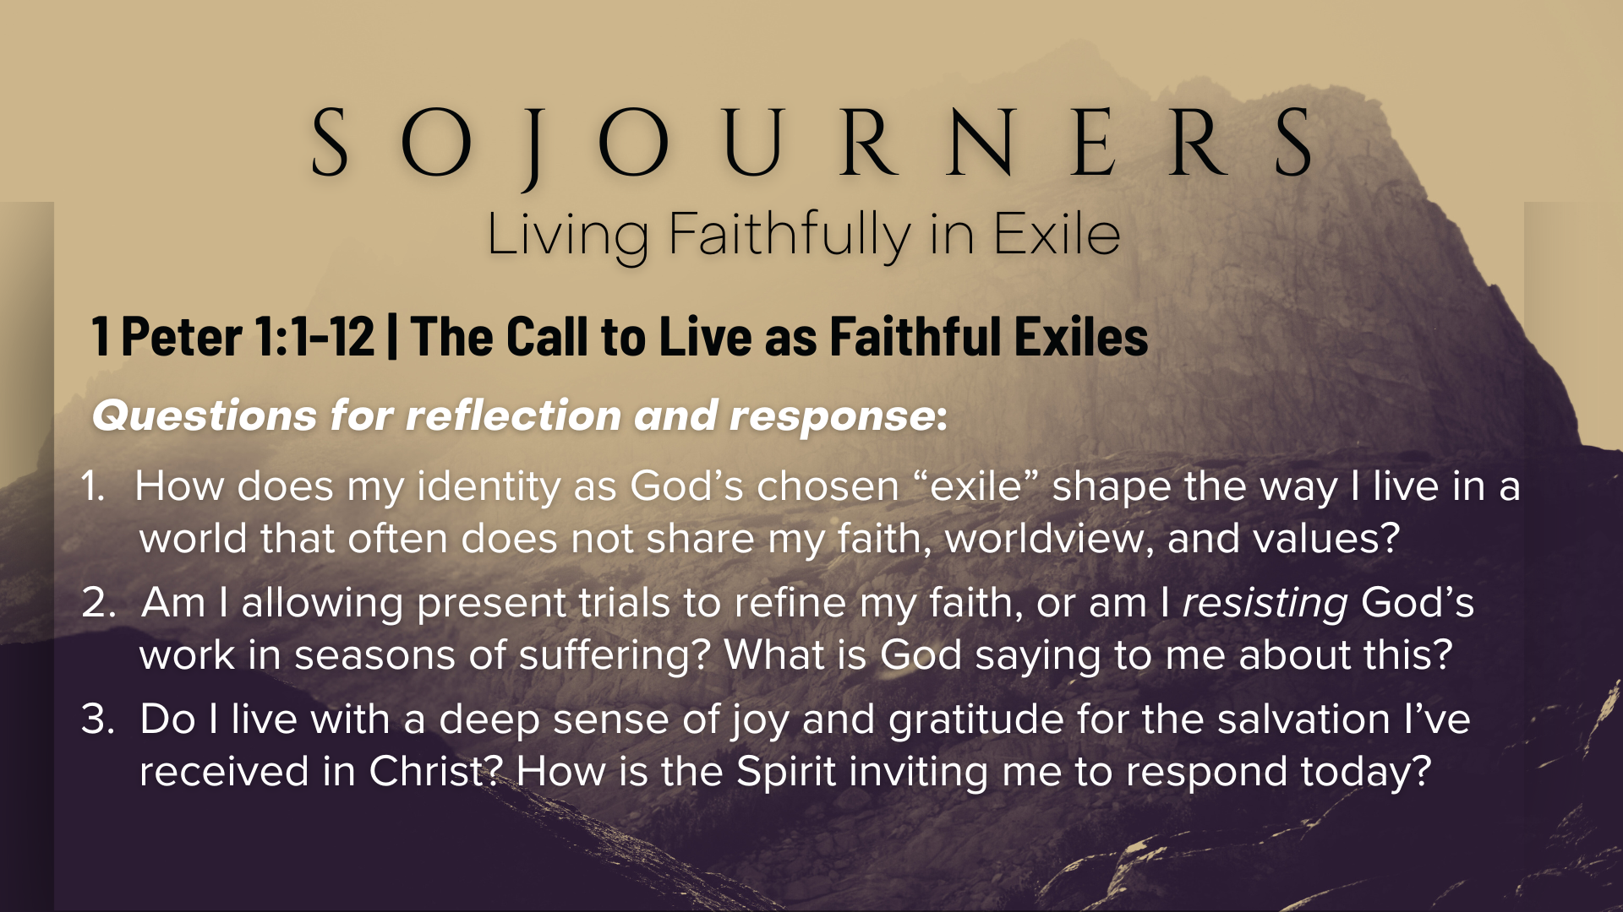
Notes:
[READ & BRIEF COMMENT ON EACH QUESTION]
How does my identity as God’s chosen “exile” shape the way I live in a world that often does not share my faith, worldview, and values?
Am I allowing present trials to refine my faith, or am I resisting God’s work in seasons of suffering? What is God saying to me about this?
Do I live with a deep sense of joy and gratitude for the salvation I’ve received in Christ? How is the Spirit inviting me to respond today?
[CLOSING WORDS]
Let’s pray… [NEXT SLIDE FOR CLOSING PRAYER]

Slide 21
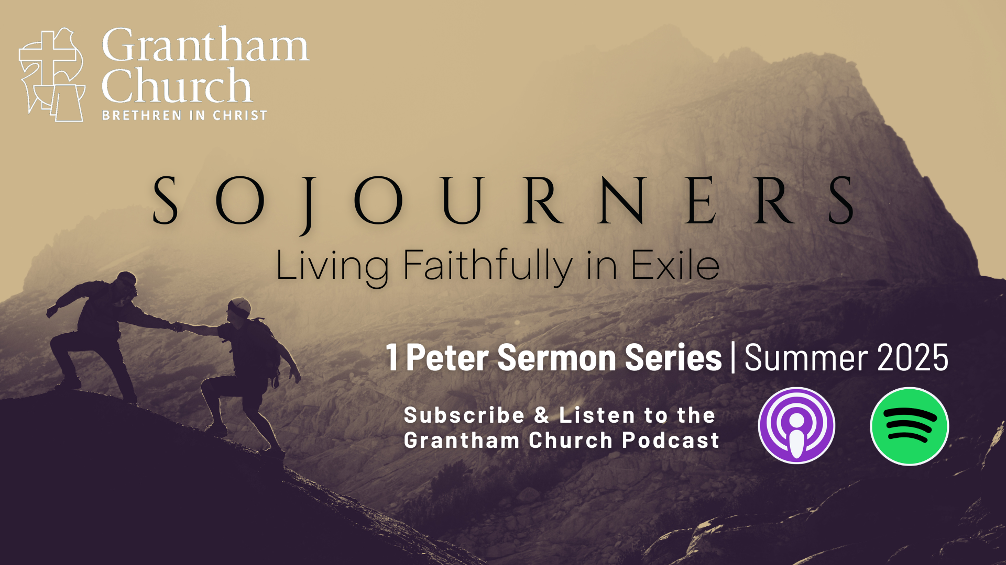
Notes:
[CLOSING PRAYER]
[APOSTLES’ CREED]
[COMMUNION]
Benediction
Chosen people of God, as sojourners and exiles in this world,
set your hearts on the Living Hope – Christ risen and reigning.
As you go into the world,
may you walk in hope,
stand firm in God’s grace,
shine with the love of Jesus,
and allow the Spirit to sustain you in all things,
until the day your sojourning gives way to glory.
Go in peace, church,
and live faithfully in exile.
Amen.

